Slide 1
Time Series Analysis of Hog Futures
Ruoting Wang
CS561

Slide 2
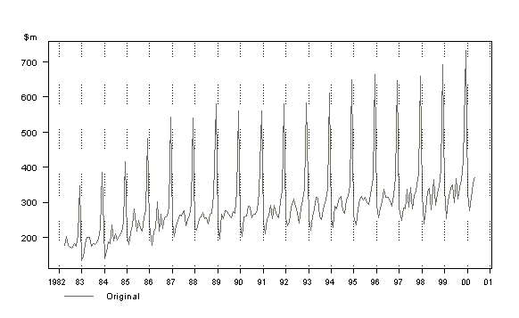
What is a Time Series?
Stochastic Process with evenly spaced intervals
Forecasting
Properties
Trend
Seasonality
Noise
Retail Sales Over Time
“Australian Bureau of Statistics Web Site.” Australian Bureau of Statistics, Australian Government, www.abs.gov.au/websitedbs/D3310114.nsf/home/Time Series Analysis: The Basics.

Slide 3
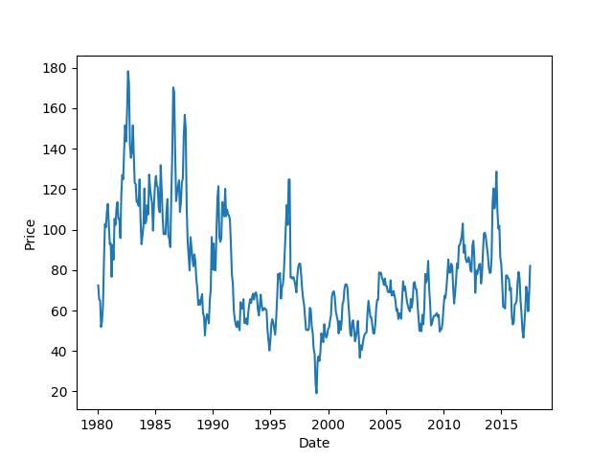
Goals of this Project
Observations of time series
Sliding Window Forecasting
ARIMA
SARIMA
Hog Futures, Monthly Data from 1980 - 2017

Slide 4
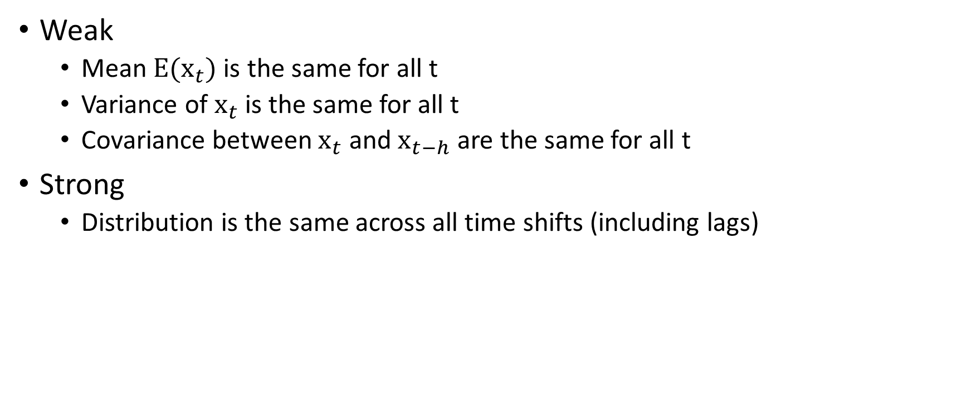
Stationary Process
Weak
Mean $E(x_{t})$ is the same for all t
Variance of $x_{t}$ is the same for all t
Covariance between $x_{t}$ and $x_{t−h}$ are the same for all t
Strong
Distribution is the same across all time shifts (including lags)

Slide 5
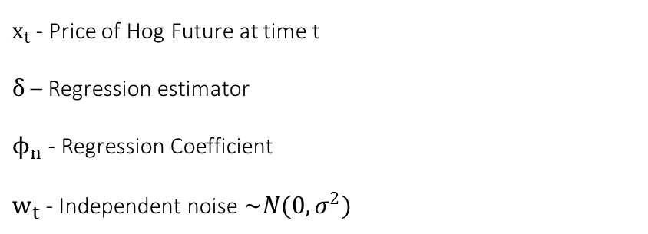

Auto-Regression (AR)
$x_{t}=δ+w_{t}$ [AR(0)]
$x_{t}=δ+ϕ_{1}x_{t−1}+w_{t}$ [AR(1)]
$x_{t}=δ+ϕ_{1}x_{t−1}+ϕ_{2}x_{t−2}+w_{t}$ [AR(2)]
$x_{t}$ - Price of Hog Future at time t
$δ$ – Regression estimator
$ϕ_{n}$ - Regression Coefficient
$w_{t}$ - Independent noise $\sim N(0, σ^{2})$

Slide 6
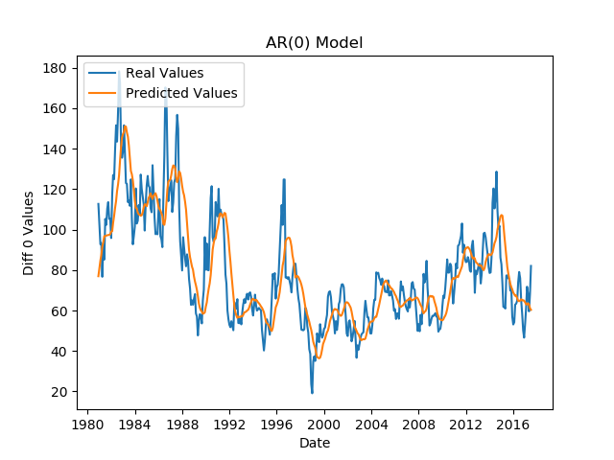
Fitting with no Auto Regression
Hog Futures, Prediction AR(0) Model Data from 1980 – 2017
Root Mean Squared Error ~$15.56

Slide 7

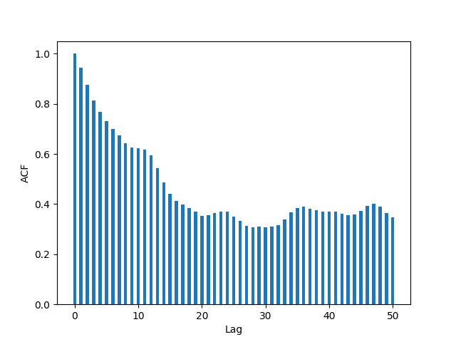
Auto-Correlation Function
Autocorrelation function (ACF)
ACF for the AR(0) function for 50 lags

Slide 8

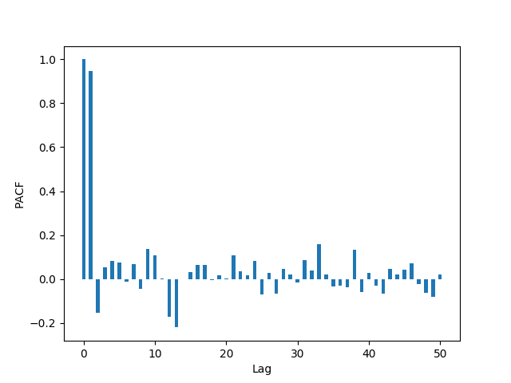
Partial Auto-Correlation Function
Partial Auto-Correlation
PACF for the AR(0) function for 50 lags

Slide 9
Statistical Tests for Stationary Series
Augmented Dickey Fuller (ADF)
Null-Hypothesis: there is a unit root
Kwiatkowski-Phillips-Schmidt-Shin (KPSS)
Null-Hypothesis: the series is stationary
Case 1: Both tests conclude that the series is not stationary -> series is not stationary
Case 2: Both tests conclude that the series is stationary -> series is stationary
Case 3: KPSS = stationary and ADF = not stationary -> trend stationary, remove the trend to make series strict stationary
Case 4: KPSS = not stationary and ADF = stationary -> difference stationary, use differencing to make series stationary

Slide 10
Results from Statistical Tests
ADF
Reject null hypothesis of root
KPSS
Reject null hypothesis that series is stationary
This fits Case 4 the best
Results of Dickey Test:
Critical Values:
 | 1%: -3.445
 | 5%: -2.868
 | 10%: -2.570
Test Statistic | -3.590515
p-value | 0.005945
Lags Used | 0
Results of KPSS Test:
Test Statistic | 12.299752
p-value | 0.010000
Lags Used | 0.000000
Critical Value (10%) | 0.347000
Critical Value (5%) | 0.463000
Critical Value (2.5%) | 0.574000
Critical Value (1%) | 0.739000

Slide 11
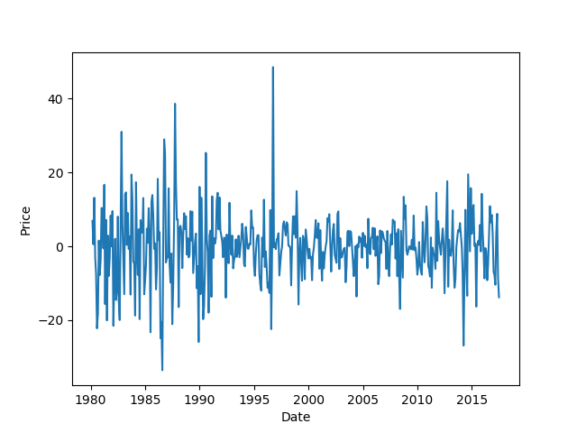
Differencing Series
Series Differencing of Hog Futures

Slide 12
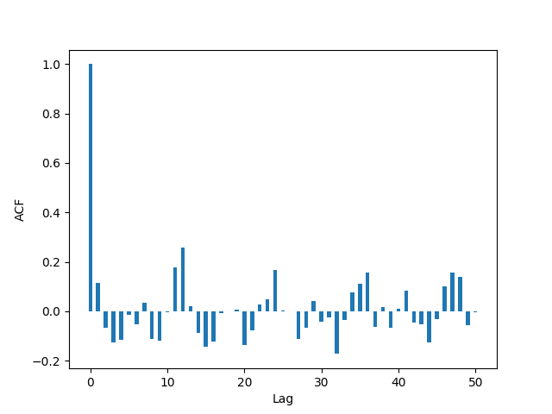
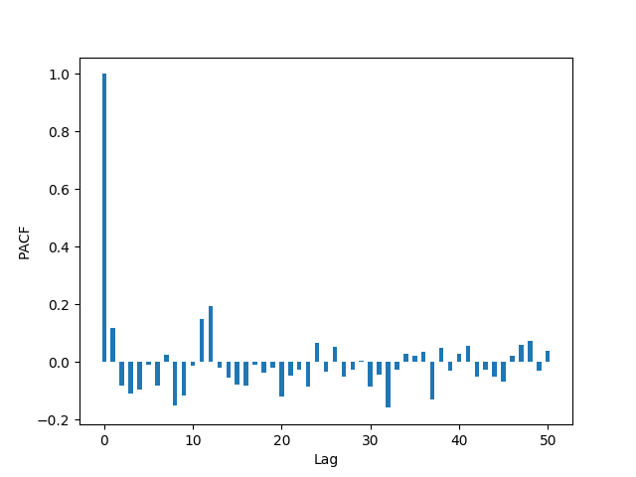
Results from ACF/PACF
ACF for the AR(1) function for 50 lags
PACF for the AR(1) function for 50 lags

Slide 13
Root MSE Analysis
Lags | Root MSE
0 | 15.55837285
1 | 10.72994824
2 | 11.67033139
3 | 16.50739725
4 | 34.59787922
5 | 111.1362817
6 | 19.3183465
7 | 12.59479868
Lags | Root MSE
0 | 9.645339189
1 | 10.37905264
2 | 12.89965461
3 | 16.0805486
4 | 45.46809757
5 | 76.28099586
6 | 19.28552085
7 | 12.61354281
Root MSE for AR(0)
Root MSE for AR(1)

Slide 14
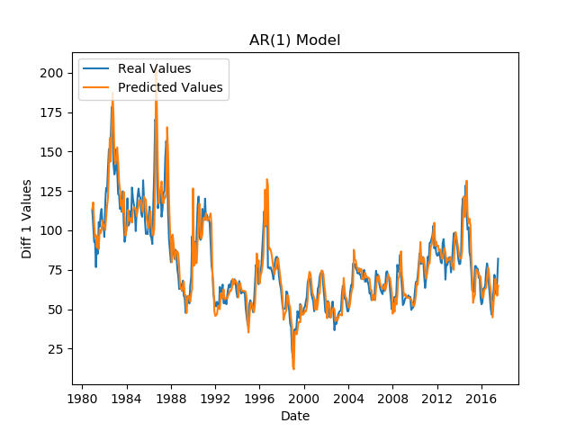
Results of Forecasting for AR(1) Model
AR(1) Forecasting for Hog Futures

Slide 15
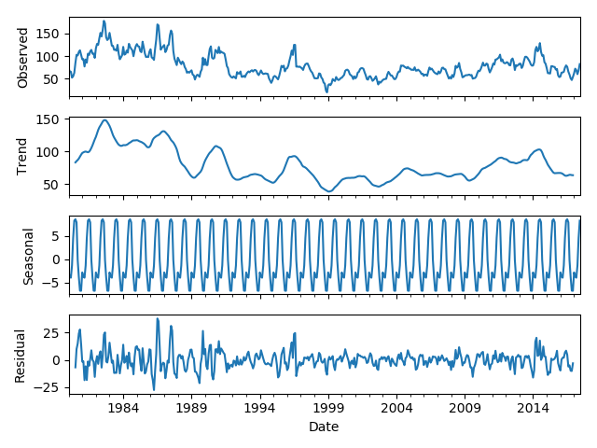
Seasonal ARIMA
Grid Search Brute Forcing ARIMA/SARIMA
SARIMA | Akaike’s Information Criteria (AIC)
ARIMA(1, 0, 2)x(2, 2, 2, 12) | 2875.193804769013
ARIMA(2, 1, 2)x(1, 2, 2, 12) | 2879.658124463105
ARIMA(0, 1, 2)x(2, 2, 2, 12) | 2880.2491591904736
ARIMA(1, 1, 2)x(2, 2, 2, 12) | 2881.0527786827993
ARIMA(2, 1, 2)x(0, 2, 2, 12) | 2881.6540130873746
ARIMA(1, 0, 2)x(1, 2, 2, 12) | 2882.275100996529
… | …

Slide 16
Future Work
Better understanding of ARIMA process
Smoothing for differenced function
Determine existence of seasonality
Questions?

Slide 17
Sources
6.4.1. Definitions, Applications and Techniques, itl.nist.gov/div898/handbook//pmc/section4/pmc41.htm.
“Australian Bureau of Statistics Web Site.” Australian Bureau of Statistics, Australian Government, www.abs.gov.au/websitedbs/D3310114.nsf/home/Time Series Analysis: The Basics.
“1.2 Sample ACF and Properties of AR(1) Model.” 1.2 Sample ACF and Properties of AR(1) Model | STAT 510, newonlinecourses.science.psu.edu/stat510/node/60/.
“A Gentle Introduction to Autocorrelation and Partial Autocorrelation.” Machine Learning Mastery, 26 Apr. 2019, machinelearningmastery.com/gentle-introduction-autocorrelation-partial-autocorrelation/.
Baskesh. “How to Use the Autocorreation Function (ACF)?” CoolStatsBlog, 12 Aug. 2017, coolstatsblog.com/2013/08/07/how-to-use-the-autocorreation-function-acf/.
Partial Autocorrelation Function" Keyword Found Websites ... www.keyword-suggest-tool.com/search/partial autocorrelation function/.
STAT 510 - Newonlinecourses.science.psu.edu. newonlinecourses.science.psu.edu/stat510/node/62/.
Singh, Aishwarya. “A Gentle Introduction to Handling a Non-Stationary Time Series in Python.” Analytics Vidhya, 23 Oct. 2018, www.analyticsvidhya.com/blog/2018/09/non-stationary-time-series-python/.
Complete Guide to Create a Time Series Forecast (with ... www.analyticsvidhya.com/blog/2016/02/time-series-forecasting-codes-python/.
“The Difference Between AR(1) and Lagged Dependent Terms.” Itron, 9 Mar. 2017, blogs.itron.com/the-difference-between-ar1-and-lagged-dependent-terms/.
“2.1 Moving Average Models (MA Models).” 2.1 Moving Average Models (MA Models) | STAT 510, newonlinecourses.science.psu.edu/stat510/node/48/.
“Bloggers | R News and Tutorials Contributed by (750) R Bloggers.” R, www.r-bloggers.com/.
“A Gentle Introduction to SARIMA for Time Series Forecasting in Python.” Machine Learning Mastery, 20 Nov. 2018, machinelearningmastery.com/sarima-for-time-series-forecasting-in-python/.

